Slide 1
Financial Aid 101
Learning the basics

Slide 2
Agenda
What is financial aid?
How to apply
After the FAFSA

Slide 3
What is financial aid?

Slide 4
Types of financial aid
studentaid.gov/understand-aid/types
Financial aid is money to help pay for college or career school. Grants, work-study, loans, and scholarships help make college or career school affordable.
Grants
Work-study
Scholarships
Loans

Slide 5
Grants
studentaid.gov/understand-aid/types/grants
Grants typically do not need to be repaid
They can come from the federal government or the institution you are attending
Eligibility for grants is determined based on financial need
Complete your FAFSA early to be considered for institutional grants
Common federal grants:
Pell grant
Federal Supplemental Educational Opportunity grant
Teacher Education Assistance for College and Higher Education (TEACH) grant

Slide 6
Work-study jobs
studentaid.gov/understand-aid/types/work-study
Federal work-study allows you to earn money to pay for school by working part-time
These jobs can be on or off campus
They are a great way to gain skills for future employment
You will be paid directly from your employer – work-study income does not apply directly to your education expenses

Slide 7
Scholarships
collegereadyaz.com/searching-for-scholarships/
Many institutions offer scholarships based on your academic performance in high school, often referred to as a merit scholarship.
There are thousands of application based scholarship opportunities that are awarded based on a student’s academics, talents, traits, interest, financial need, where you are from, where your parents work and many other factors.
Contact the schools you are applying to in order to learn more about application based scholarship opportunities or visit the site linked above.

Slide 8
Loans
studentaid.gov/understand-aid/types/loans/subsidized-unsubsidized
Federal student loans have a fixed interest rate that is typically lower than private loans
Direct Subsidized Loan – only available to students who demonstrate financial need based on their FAFSA. This loan does not accrue interest until 6 months after graduation or dropping below half-time enrollment.
Direct Unsubsidized Loan – offered to all students eligible for federal student aid. Unsubsidized loans start accruing interest once they disburse.
Repayment doesn’t begin until 6 months after graduation or dropping below half-time enrollment.

Slide 9
Loans
studentaid.gov/understand-aid/types/loans/subsidized-unsubsidized
Year | Dependent undergraduate student | Independent undergraduate student
First year (0-24 credits) | $5,500 | $9,500
Second year (25-55 credits) | $6,500 | $10,500
Third year Fourth year (56+ credits) | $7,500 | $12,500
Maximum total debt from federal student loans when you graduate (i.e., your aggregate loan limits) | $31,000 | $57,500

Slide 10
Loans
studentaid.gov/understand-aid/types/loans
Parent PLUS Loan
Parents may apply for this loan, it is not guaranteed that all applicants will be approved for the Parent PLUS loan
Application for the Parent PLUS loan requires a credit check – you may be eligible to receive the Parent PLUS loan if you meet additional requirements
Repayment begins within 60 days of full disbursement

Slide 11
Loans
studentaid.gov/understand-aid/types/loans
Responsible borrowing tips:
Only borrow money that you need
Make a plan for repayment – loans don’t just go away
Learn about starting salaries for your field of study
Ask your school or loan servicer how withdrawing from school will affect your loan
Make payments on time

Slide 12
Arizona Promise Program
collegereadyaz.com/promise/
This program covers a qualifying student’s tuition and fees at an Arizona public university if they meet the following criteria:
Be an Arizona resident, graduating from an Arizona high school with a 2.5 GPA or higher
Complete the FAFSA and apply to one or more of Arizona’s public universities by April 1 of their senior year
Eligible to receive the federal Pell grant
Enroll at ASU, NAU or U of A
The Arizona Promise Program is renewable for a total of four consecutive years if the student remains Pell eligible, completes 24+ credits each academic year and maintains a 2.5 GPA or higher.

Slide 13
How to apply for financial aid

Slide 14
FAFSA
studentaid.gov/fafsa
The Free Application for Federal Student Aid, also known as FAFSA, allows students to be evaluated for federal, state and institutional financial aid opportunities.
This form is free and should be completed by all eligible students each year in order to maximize your financial aid package.
Students entering college, university, or technical schools fall 2026 should complete the 2026-2027 FAFSA form.

Slide 15
FAFSA
studentaid.gov/fafsa
The FAFSA opens October 1 every year
Each institution sets their own FAFSA priority date or deadline - be sure to complete your FAFSA early in order to be evaluated for the maximum amount of federal, state, and institutional aid.

Slide 16
Federal aid eligibility
studentaid.gov/understand-aid/eligibility
Students must meet the following criteria:
Be a U.S. citizen or eligible noncitizen (including permanent residents, refugees and asylees)
Attend a participating college or university
Enroll in a degree-seeking program
Maintain satisfactory academic progress (SAP)
Check with your institution to determine its standards

Slide 17
FAFSA Vocabulary
studentaid.gov/fafsa
Contributor – anyone who is providing information on the FAFSA form (e.g., student, student’s spouse, or student’s parents)
Parent – the student’s biological or adoptive parent or stepparent (regardless of who may claim the student on tax their tax return
Dependency Status – students answer a series of questions on the FAFSA to determine whether the student is considered dependent or independent. Dependent students will need parental information in order to submit the FAFSA form

Slide 18
Starting the FAFSA
studentaid.gov/h/apply-for-aid/fafsa
Create your studentaid.gov account – the student and any contributors will need to create their own accounts in order to login, sign, and submit the FAFSA form
Gather all necessary information
Studentaid.gov account username and password
Social Security number or Alien Registration number
2024 tax information, if applicable
Current balance of cash, checking, and savings accounts
Records of net worth of investments (retirement accounts are not included)
Records of untaxed income, if applicable

Slide 19
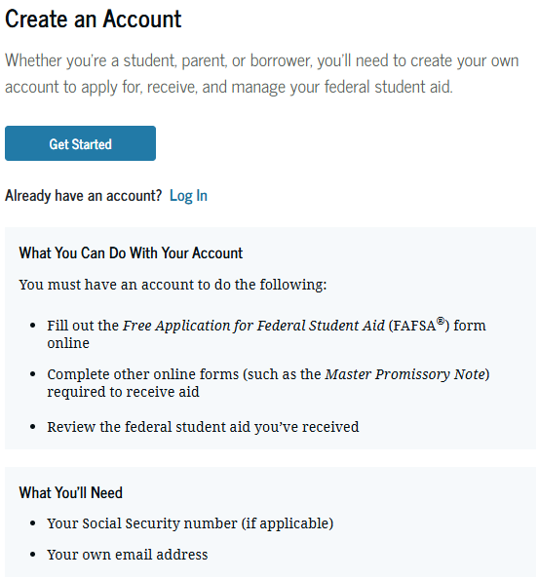
Studentaid.gov account
studentaid.gov/fsa-id/create-account
Each Studentaid.gov account must have a unique personal email address and phone number
All contributors (student, parents and/or spouse) must have their own Studentaid.gov account
Parents without a Social Security number can create a Studentaid.gov account
Instant identity verification with the Social Security Administration, if reporting a Social Security number

Slide 20
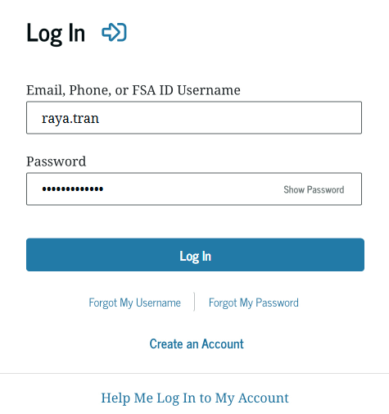
Starting the FAFSA
studentaid.gov/fsa-id/sign-in
Log in to your account on studentaid.gov once you have successfully created your account
You can use your verified phone number, email address, or username to log in
Use the “Forgot My Username” or “Forgot My Password” tools to reset your account
This will lock your account for 30 min

Slide 21
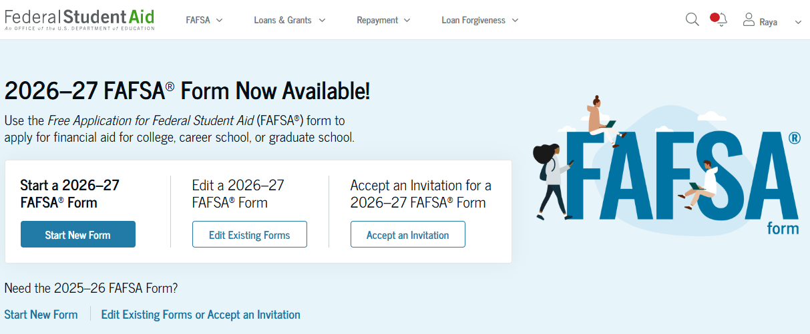
2026-2027 FAFSA
studentaid.gov/h/apply-for-aid/fafsa
Select the 2026-2027 FAFSA form

Slide 22
After the FAFSA

Slide 23
After the FAFSA
studentaid.gov/fafsa
Students will receive their FAFSA Submission Summary once their FAFSA has been submitted. The FAFSA Submission Summary is a summary of all responses provided on the FAFSA form and contains an estimate of the student’s federal aid eligibility along with your Student Aid Index (SAI).
Your SAI is an index number calculated by completing the FAFSA used to determine eligibility for federal student aid.
Federal Student Aid will send your FAFSA data to the schools you listed on your FAFSA form once your FAFSA has been processed (processing typically takes 3-5 business days).

Slide 24
After the FAFSA
studentaid.gov/fafsa
Contact each school that you listed on your FAFSA to confirm that your FAFSA has been received and determine when the school will begin awarding financial aid.
Approximately 1 in 3 students is selected for financial aid verification. If selected, the student will need to provide additional information to each institution listed on the FAFSA in order to receive their financial aid offer.
Once your file is complete, you will receive an official notification from each school that you apply to and send your FAFSA to. The Financial Aid Offer will contain all grants, scholarships, loans, and work-study you have received.

Slide 25
After the FAFSA
studentaid.gov/fafsa
Cost of attendance (COA) is the estimated total cost to attend an institution including tuition, fees, housing, food, books, supplies, travel, and personal expenses.
Use your Financial Aid Offer along with your school’s cost of attendance to determine what your estimated out of pocket cost will be.
Compare your estimated costs at each institution to make an informed financial decision about which school to attend.

